Slide 1

COFFEE SALES ANALYSIS
PRESENTED BY:
Rajat Bahuguna

Slide 2

Company Overview
Challenges and Objectives
Agenda
Methodology
Overall Analysis
Digging Deeper
Recommendations
Get in Touch

Slide 3
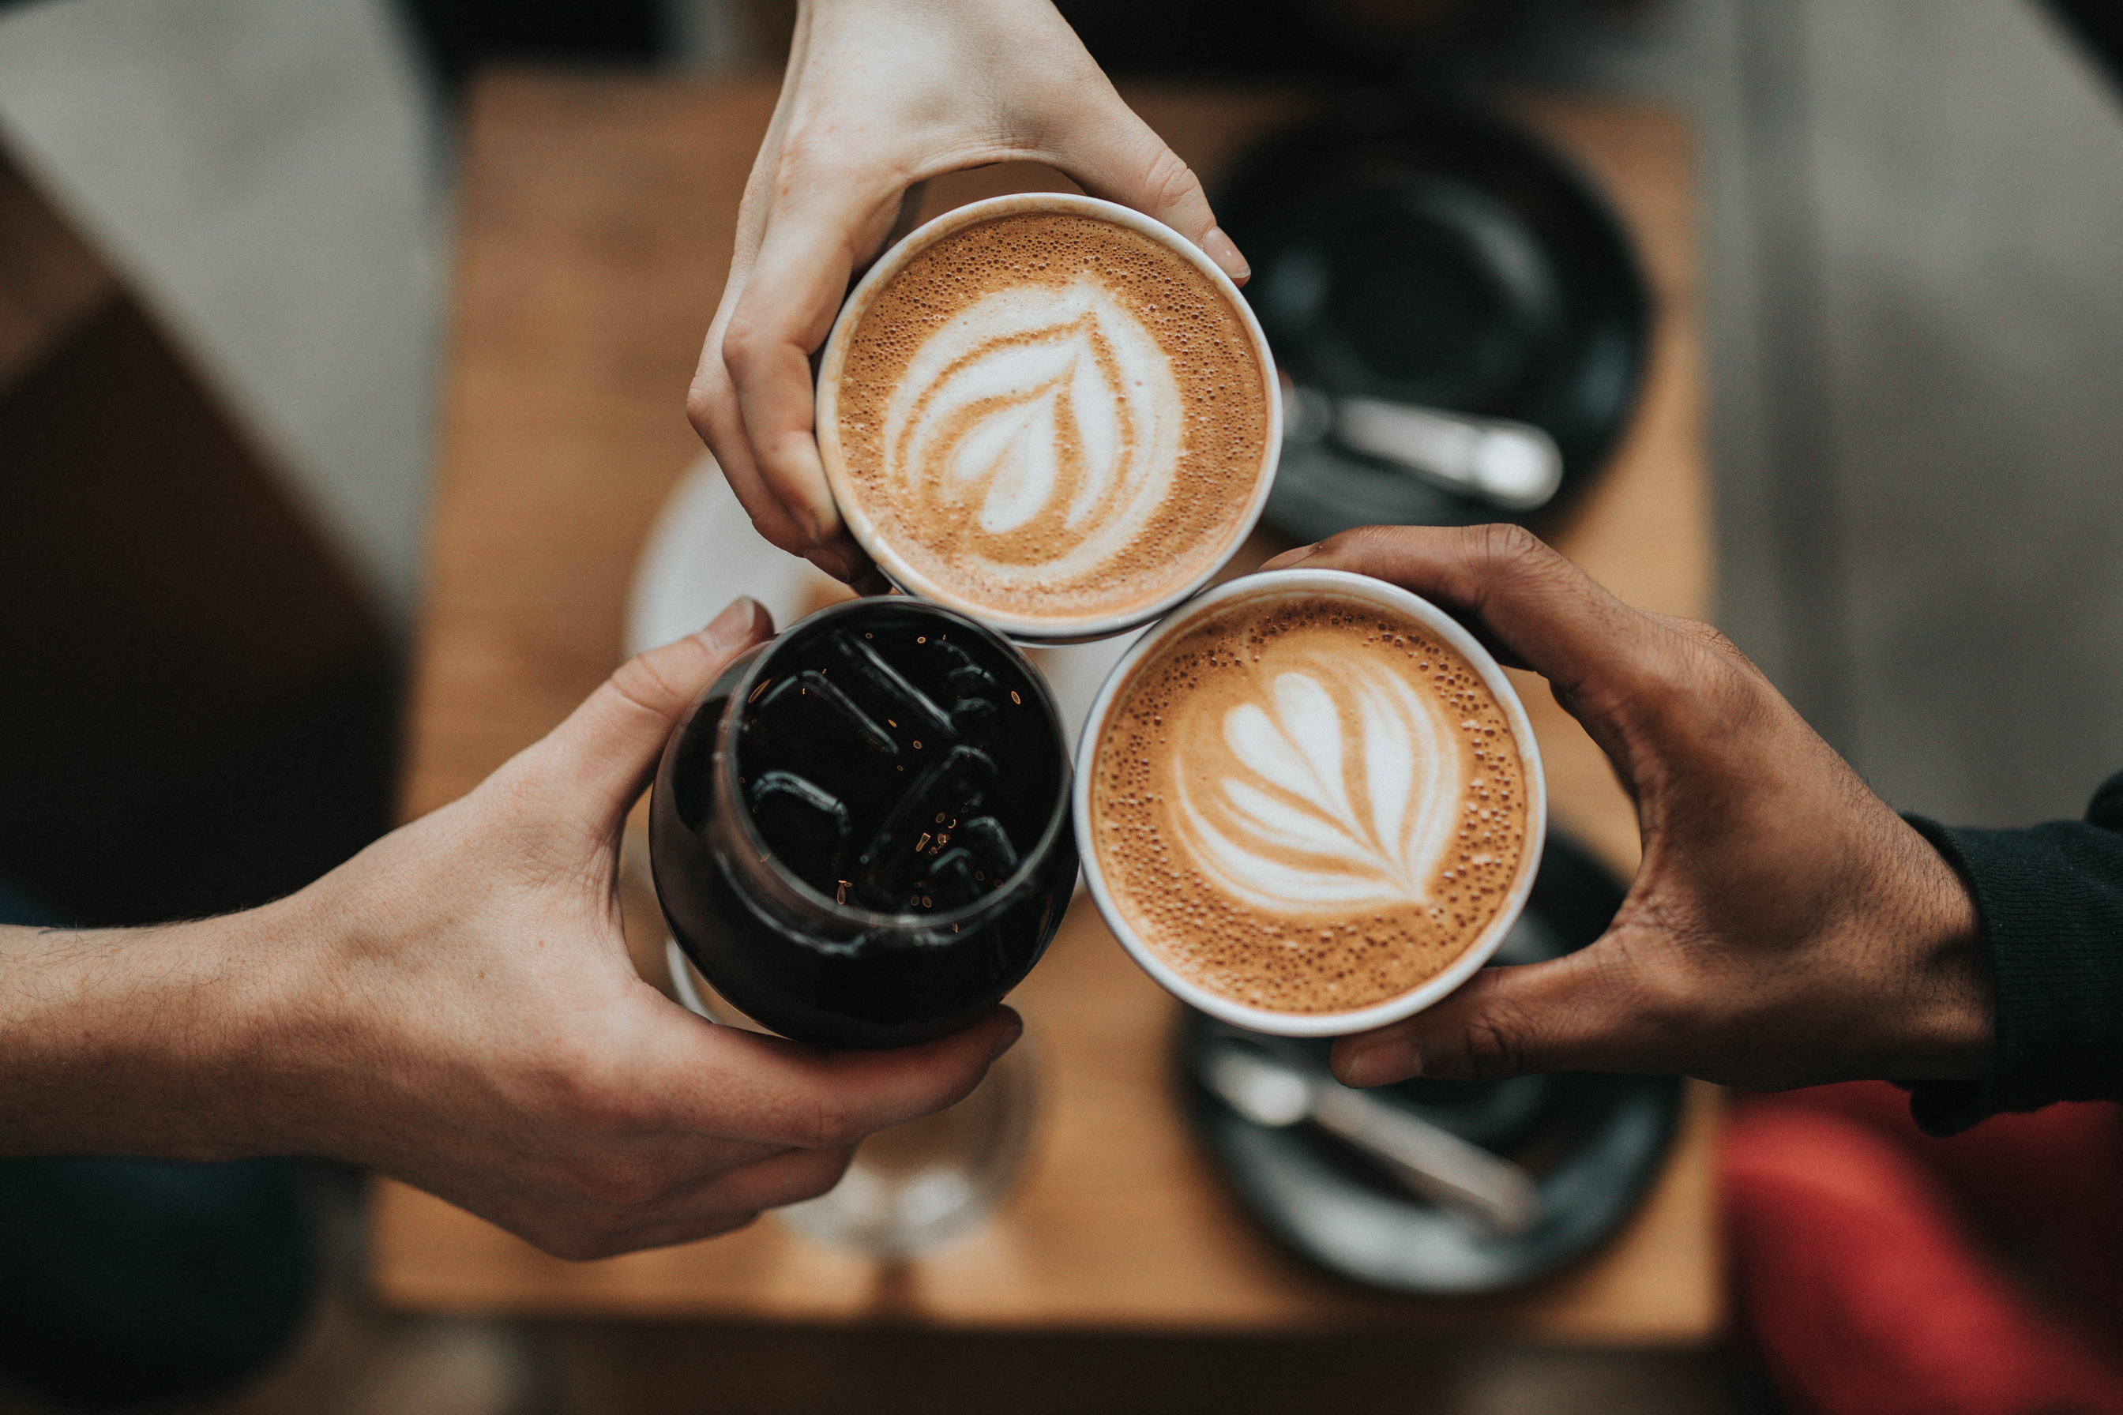
Company Overview
Maven Roasters, a fictitious coffee shop operating out of three NYC locations namely Astoria, Hell’s Kitchen and Lower Manhattan.
Back to Agenda

Slide 4


Challenges
and Objectives
Back to Agenda
Objectives
Design an Exploratory Dashboard which includes summarises all three store locations.
Define key metrics to quantify business outcome.
Generate key insights and present them to stakeholders.
Challenges
Store has been open for six months now and shop owner wants to understand how his business is performing overall in all three locations.

Slide 5

Methodology
Back to Agenda
01
02
03
Overall Analysis
Drilling Deeper
Recommendations
Perform overall analysis and generate surface level insights for each variable.
Drill deeper to check month-wise, day-wise, hourly and store-wise sales to uncover deeper insights.
Based on our insights, we will recommend some suggestions to improve the business

Slide 6


Overall Analysis
Back to Agenda
01
Monthly Sales
Weekly Sales and Orders
Hour of Day
Store Orders and Revenue
Product Category
Product Type
Size of Coffee Cup

Slide 7

Monthly Sales
Back to Agenda
Total revenue has doubled from January to June.
Total Revenue surged from $82K in January to $167K in June, reflecting a significant growth over six months.

Slide 8
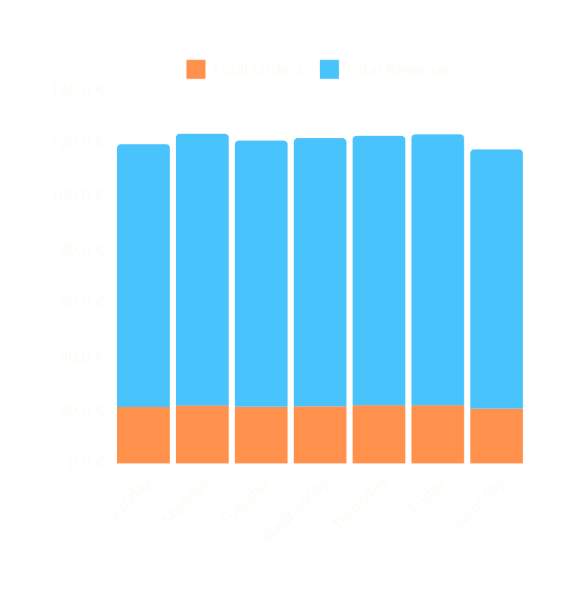

Weekly Sales and Orders
Back to Agenda
Overall Weekly Sales and Orders are uniform.
Total Revenue and number of orders remains uniform over the weekdays.

Slide 9
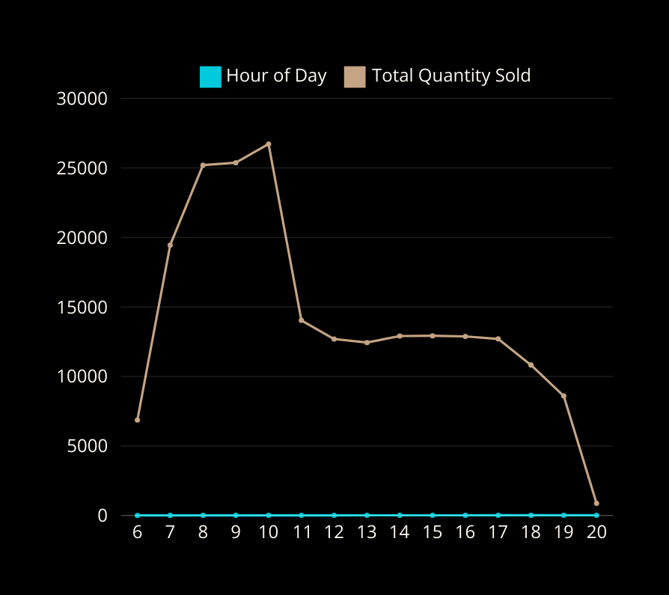
Hour of Day
Back to Agenda
Number of Coffees sold peaks around 10 AM.
Coffee sales rise from 6 AM, peaking at 10 AM daily.
This pattern is roughly same for each day of the week.
Post-10 AM, sales decline gradually and stabilise between 12 PM and 5 PM (around afternoon).

Slide 10

Store Orders & Revenue
Back to Agenda
Total Orders and Revenue is same across all stores.
Overall total revenue and total number of orders remain same across different stores. This means business is performing roughly same across all locations.

Slide 11
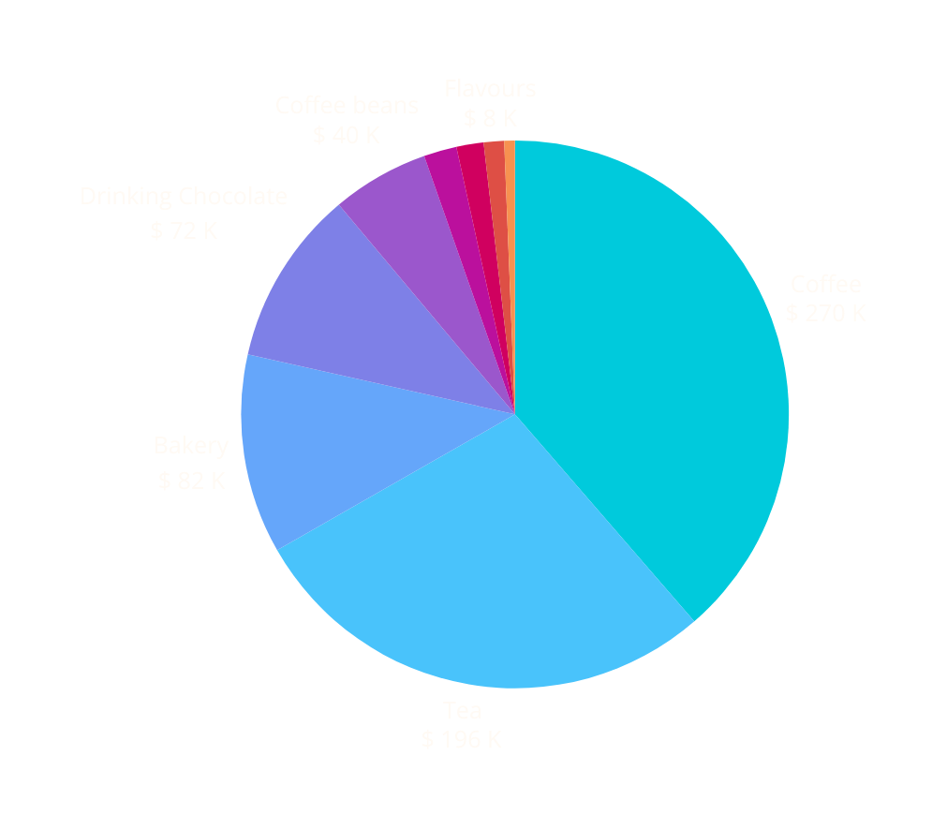
Product Category
Back to Agenda
Coffee and Tea generate most of the revenue in product category.
Coffee and Tea followed by Bakery are most popular amongst the customers. Bakery makes sense and people usually order light snacks with beverage they are ordering.

Slide 12
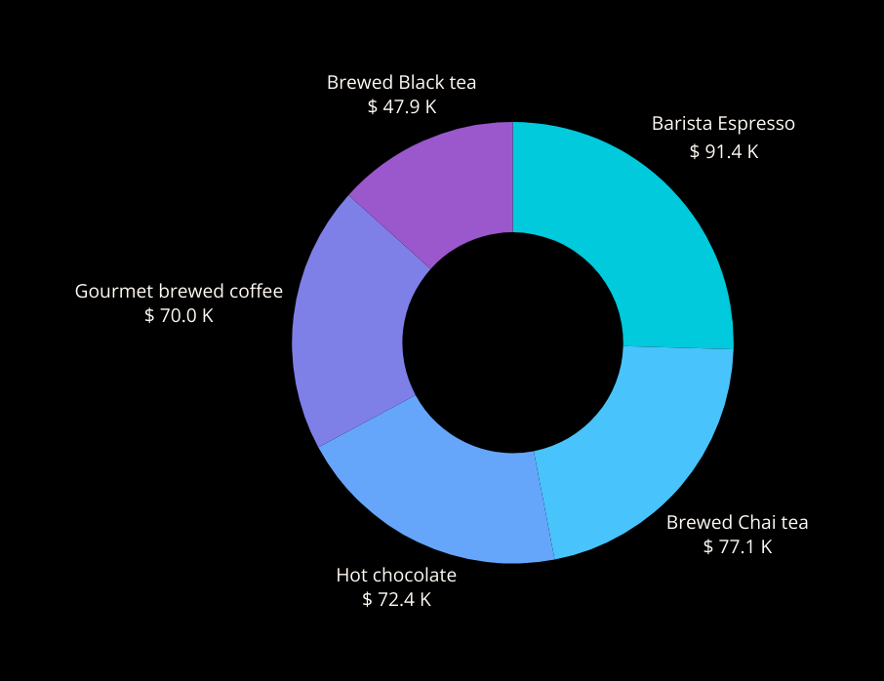
Product Type
Back to Agenda
Barista Espresso and Brewed Chai generate most revenue.
Coffee and Tea were already popular product category, drilling them further shows that Barista Espresso and Brewed Chai tea generate most overall revenue, followed by Hot Chocolate.
It seems young customers (including children) prefer Hot Chocolate.

Slide 13
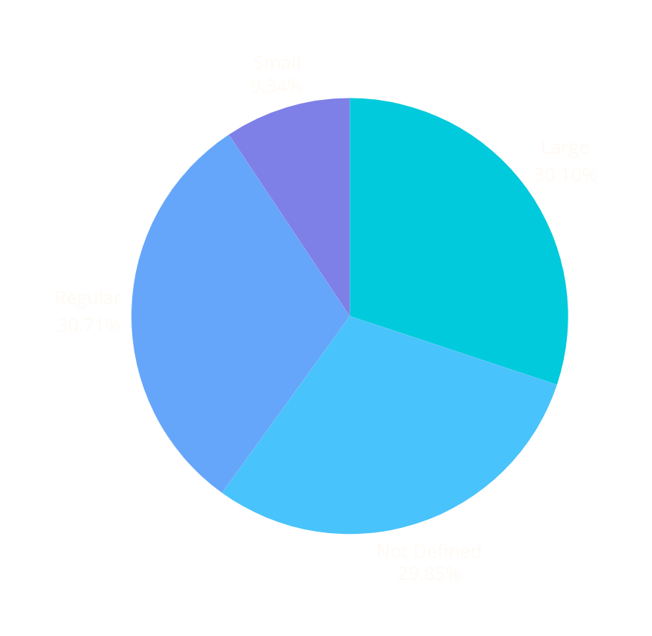
Size of Coffee Cup
Back to Agenda
Small size is least popular amongst customers.
Most customers prefer large or regular coffee size (although for many it is not defined).
Very few (roughly 10%) of the customers prefer small size coffee.

Slide 14

Digging Deeper
Back to Agenda
02
Hour by Hour Insights
Comparison by Hour
Hourly Sales by Store

Slide 15

Hour by Hour Insights
Back to Agenda
In 7th hour, Lower Manhattan has the highest revenue.
Astoria (store location) does not open at 6 AM (opens at 7 AM) and closes early (is not open at 8 PM).
Lower Manhattan has highest number of orders and total revenue at that time.

Slide 16
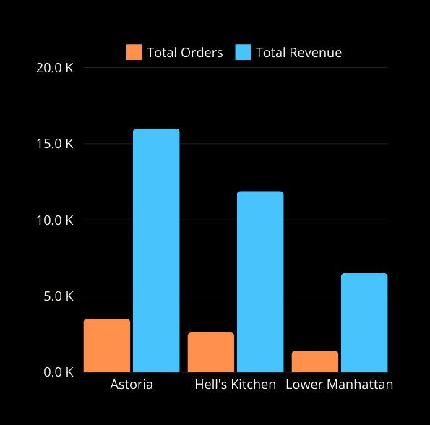


Comparison by Hour
Back to Agenda
It was observed that overall throughout the day, revenue and orders are highly correlated for all stores. And there was no anomaly in terms of business.
There were similar patterns in terms of product categories sold and size of the product too.
Total Orders and Revenue (6 PM)
Total Orders and Revenue (7 PM)
Observation: Both revenue and orders decrease significantly for Lower Manhattan at 7 PM. Are there any factors involved? It is recommended to let the business owner know about this.

Slide 17
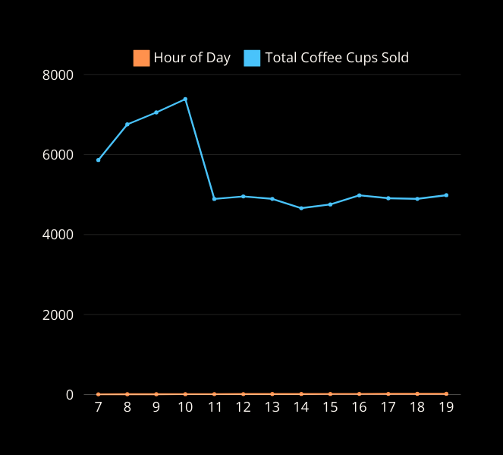
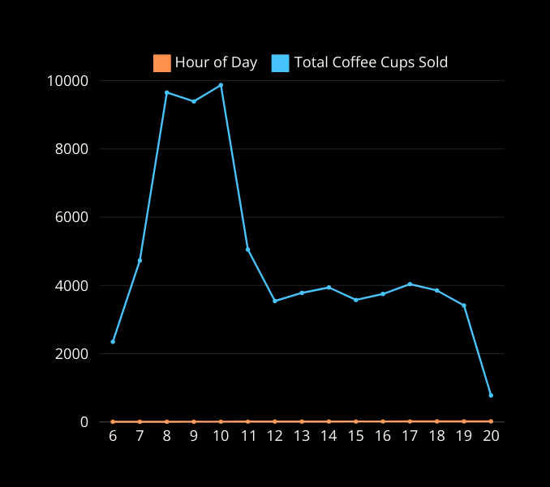
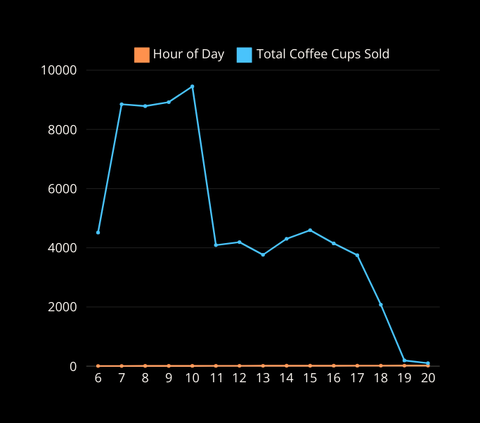
Hourly Sales by Store
Back to Agenda
Astoria’s hourly coffee cups sold
Hell’s Kitchen hourly coffee cups sold
Lower Manhattan’s hourly coffee cups sold
Astoria peaks at around 10 AM, drops after it and remains roughly same after 11 AM for entire day.
Hell’s Kitchen peaks twice (8 AM and 10 AM) but drops significantly after 10 AM but remains uniform after 12 PM.
Lower Manhattan peaks twice (7 AM and 10 AM) but drops after 10 AM, remains uniform after 11 AM eventually decreasing after 4 PM.
Astoria is a consistent performer (without serious dips with good quantity sold), Hell’s Kitchen is second and Lower Manhattan is third.

Slide 18

Recommendations
03
Back to Agenda
Expand Morning Rush Capacity
Since sales peak from 6 AM to 10 AM, consider adding more baristas, self-service kiosks, or express counters during these hours to reduce wait times and handle the rush efficiently.
Focus on Popular Sizes
Promote large and regular sizes with slight discounts or bundled offers, as they are more popular. Consider redesigning the small size or repositioning it as a budget-friendly option to increase its appeal.
Promote Afternoon Specials
Sales remain uniform between 12 PM and 5 PM, suggesting an opportunity to boost this period with promotions like “Afternoon Happy Hour” discounts or combo deals on coffee, tea, and bakery items.
Leverage Digital Channels
Use data from consistent sales patterns to send targeted promotions through mobile apps or loyalty programs during off-peak hours to drive additional traffic.
Enhance Product Variety
Since Barista Espresso, Brewed Chai Tea, and Hot Chocolate are popular, consider introducing seasonal or limited-time variations of these drinks to maintain interest and attract repeat customers.
Test and Introduce New Bakery Items
Since bakery items are among the top revenue generators, experimenting with new offerings like healthier options or seasonal treats can attract more customers and increase overall basket size.

Slide 19
Continued...
Back to Agenda
Optimize Hours of Operation for Astoria
Since Astoria doesn’t open at 6 AM and closes early after 7 PM, missing key business hours. Extending operating hours could capture early morning and late evening customers, potentially boosting sales.
Introduce mid-morning snacks
Given the drop after 10 AM, introduce mid-morning snacks or coffee refills to keep the momentum going.
Address the Evening Decline in Lower Manhattan
Lower Manhattan’s revenue and orders drop significantly at 7 PM. Analyze factors such as staff availability, customer feedback, safety concerns, or nearby competition affecting evening traffic, and communicate findings to the business owner.
Enhance Afternoon Engagement for All Locations
Promote both Hell’s Kitchen and Lower Manhattan experience steady sales after their respective morning peaks. Engage customers with loyalty rewards, exclusive afternoon deals, or sampling events to boost afternoon traffic.
Capitalise on Astoria’s Consistency
Astoria’s steady performance without significant dips positions it as a reliable location. Highlight this stability in marketing efforts to attract customers seeking a dependable spot throughout the day.

Slide 20


Slide 21

to Agenda
Get In Touch
Email
Rajatbahuguna4445@gmail.com
Social Media
@RajatBahuguna

